Slide 1


Toss GME Cooperation
2022.09.19 By Subash

Slide 2

Contents
Objective
GME’s Strengths
GME’s Money Transfer Growth
Toss GME Cooperation

Slide 3
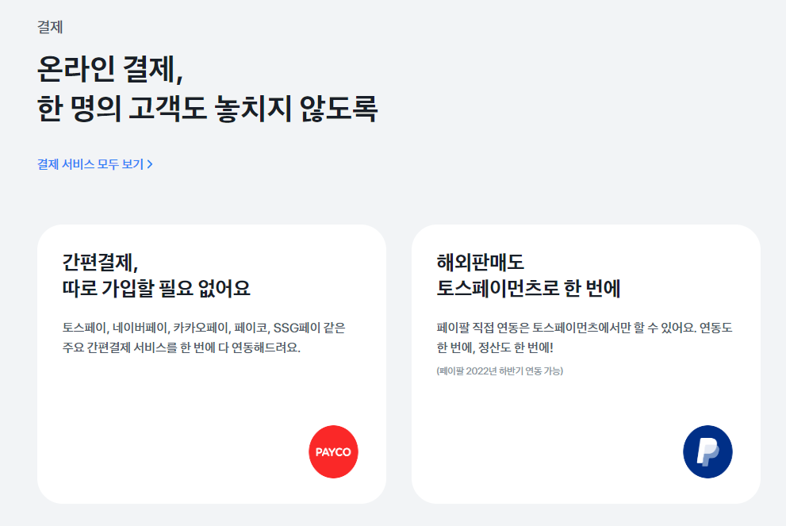
I. Objective
Use Toss’s Online Payment API for GME’s Customers

Slide 4
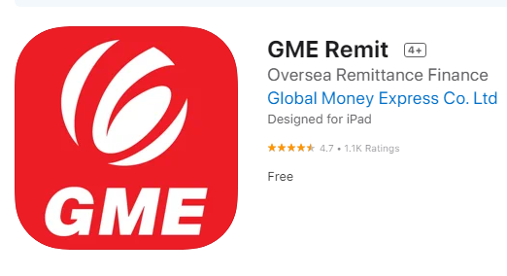
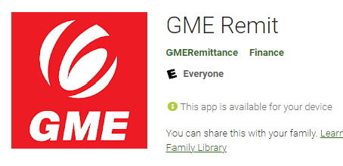

II.a) Strengths
1
1st License Holder And 1st Service Provider In Korea for X-Border transfer
2
E-KYC enable Mobile App
3
Invested by IME Group, Nepal
GME has Over 10% Market Share in Migrants Money Transfer in Korea
4
5
12 Nationwide Branches in Korea

Slide 5
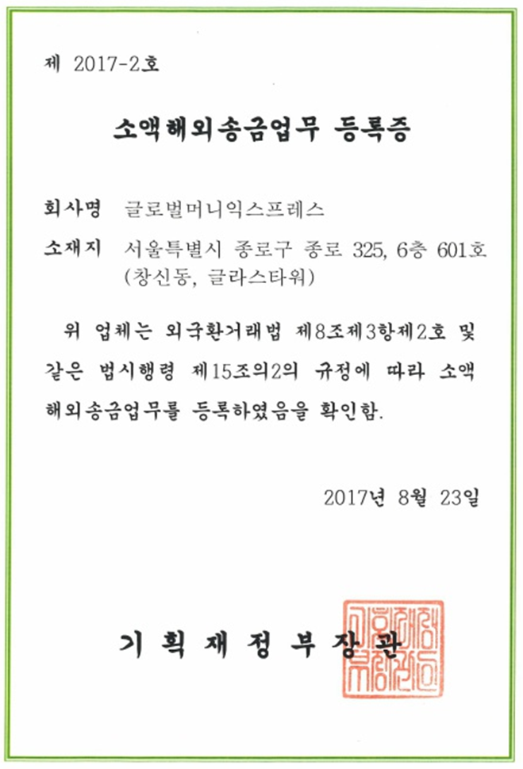
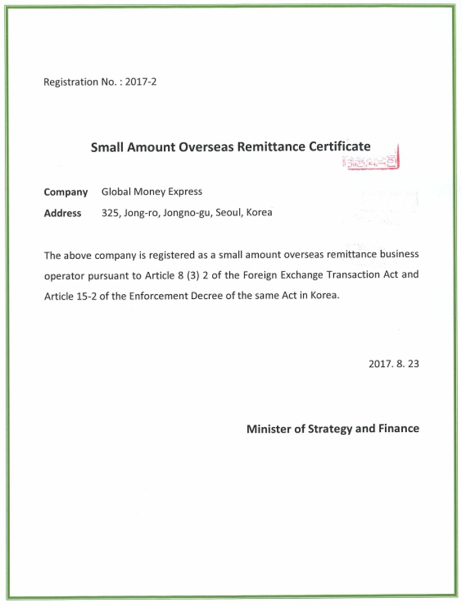
II.b) Strengths
1-1) First License Holder And Service Provider
English version

Slide 6
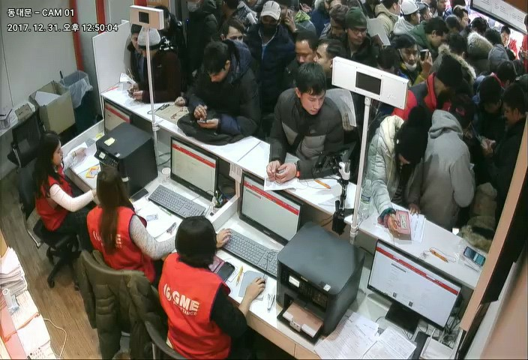
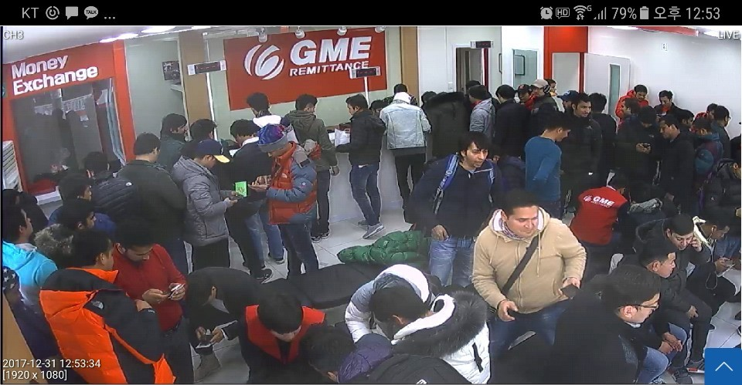
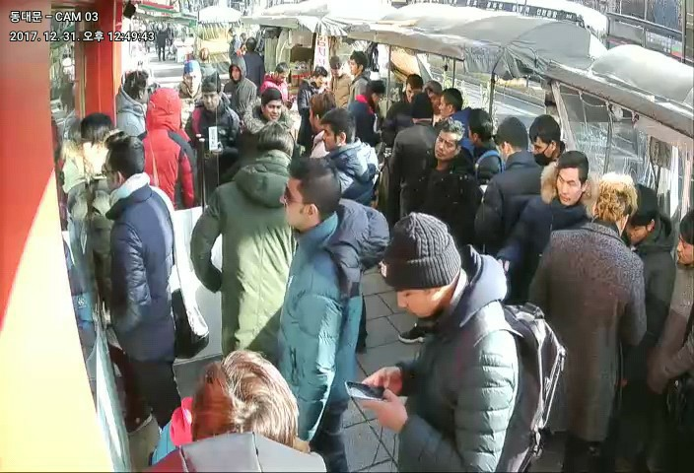
II.c) Strengths
1-1) First License Holder And Service Provider
Counter
Inside
Outside
Branches On The First Day Of Operation (2017-10-08)

Slide 7
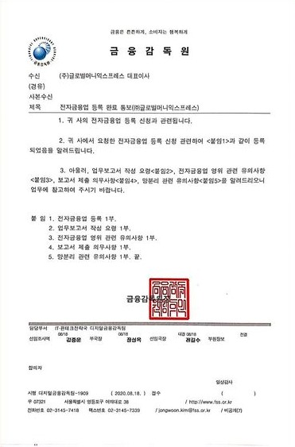
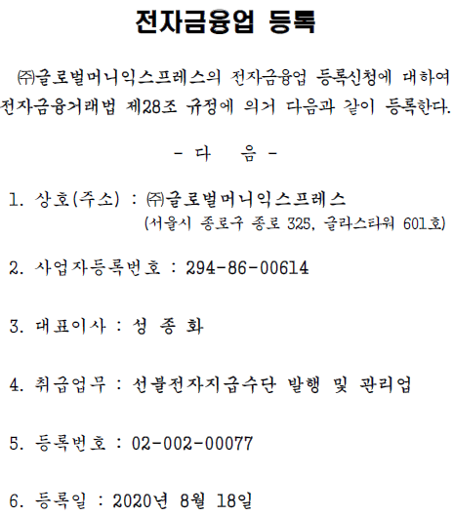
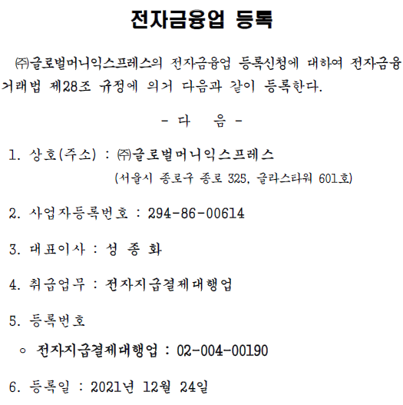
II.d) Strengths
1-2) E-Prepayment License Holder- Prepayment, PG

Slide 8

II. e) Strengths
4) Mobile App
Fast Remit
Wallet Service
Local Bank Transfer
ATM Cash Payout
Mobile Coupon Service
Top-up Service: World Wide H.P.
Money Exchange
Easy Loan

Slide 9
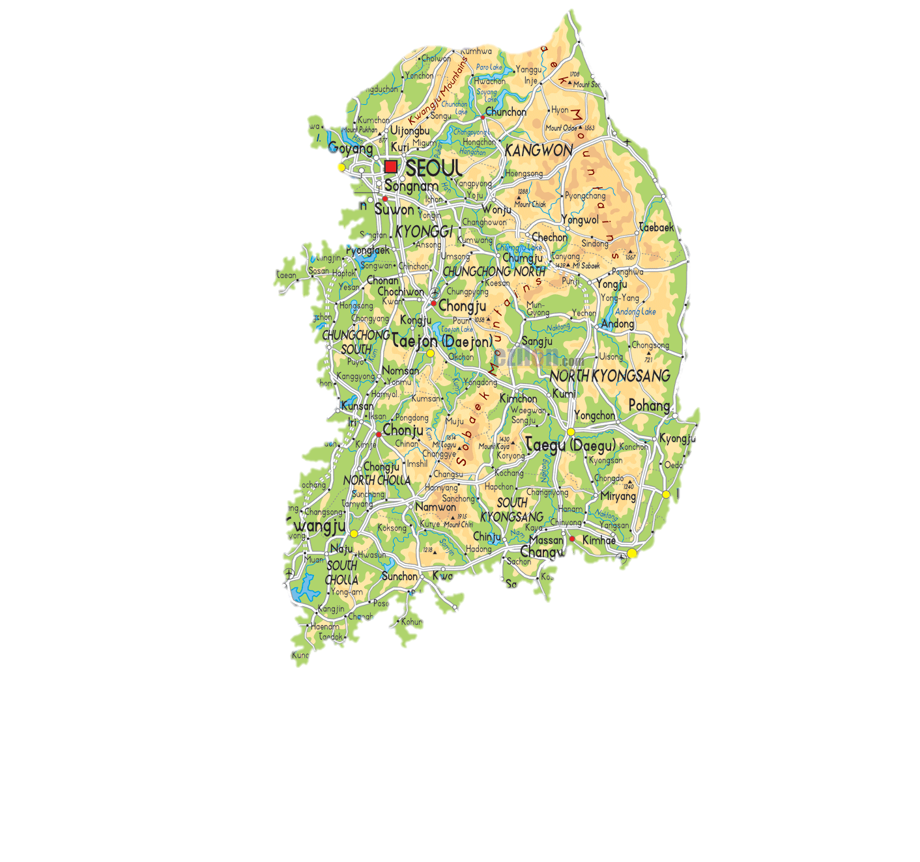
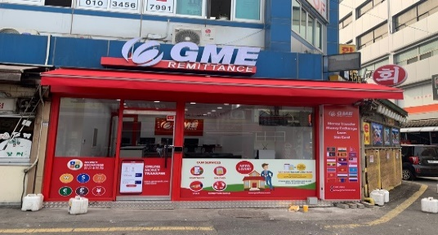
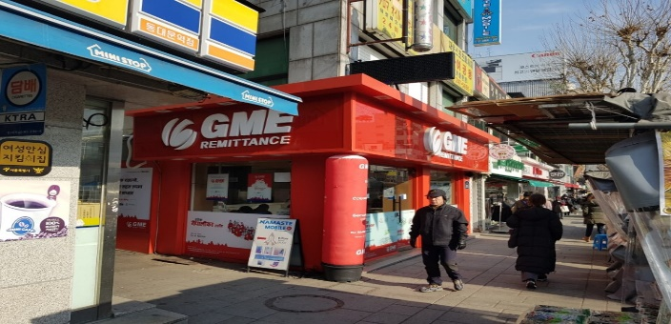
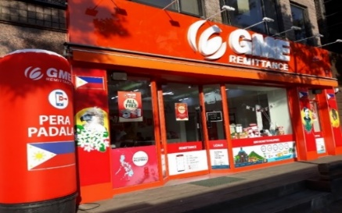
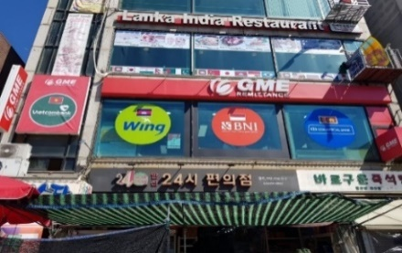
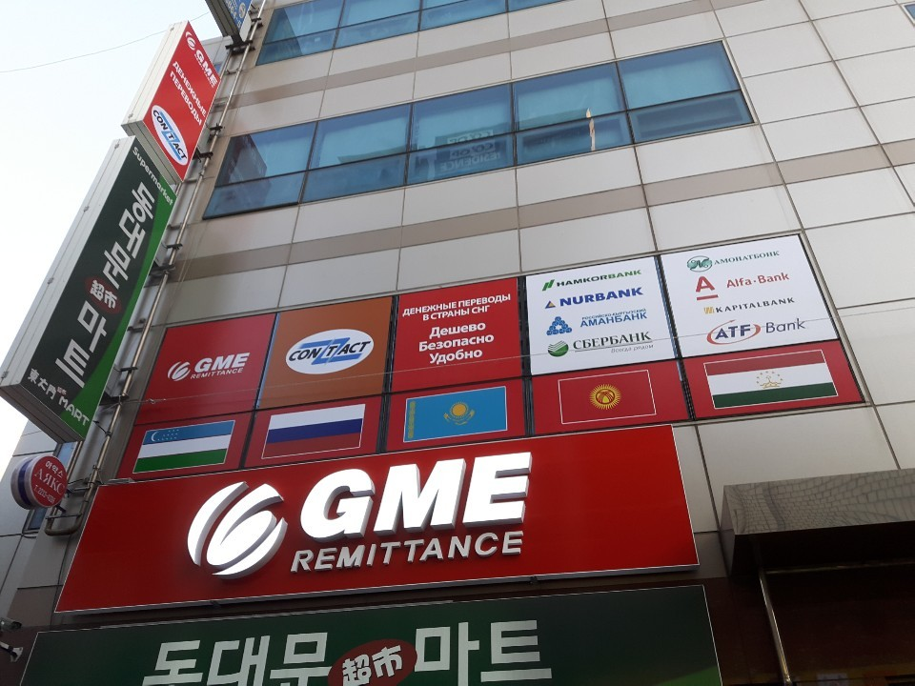

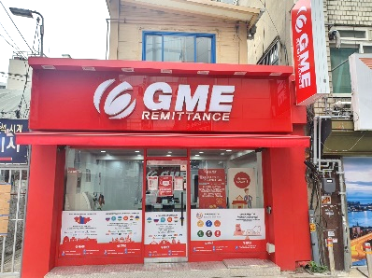
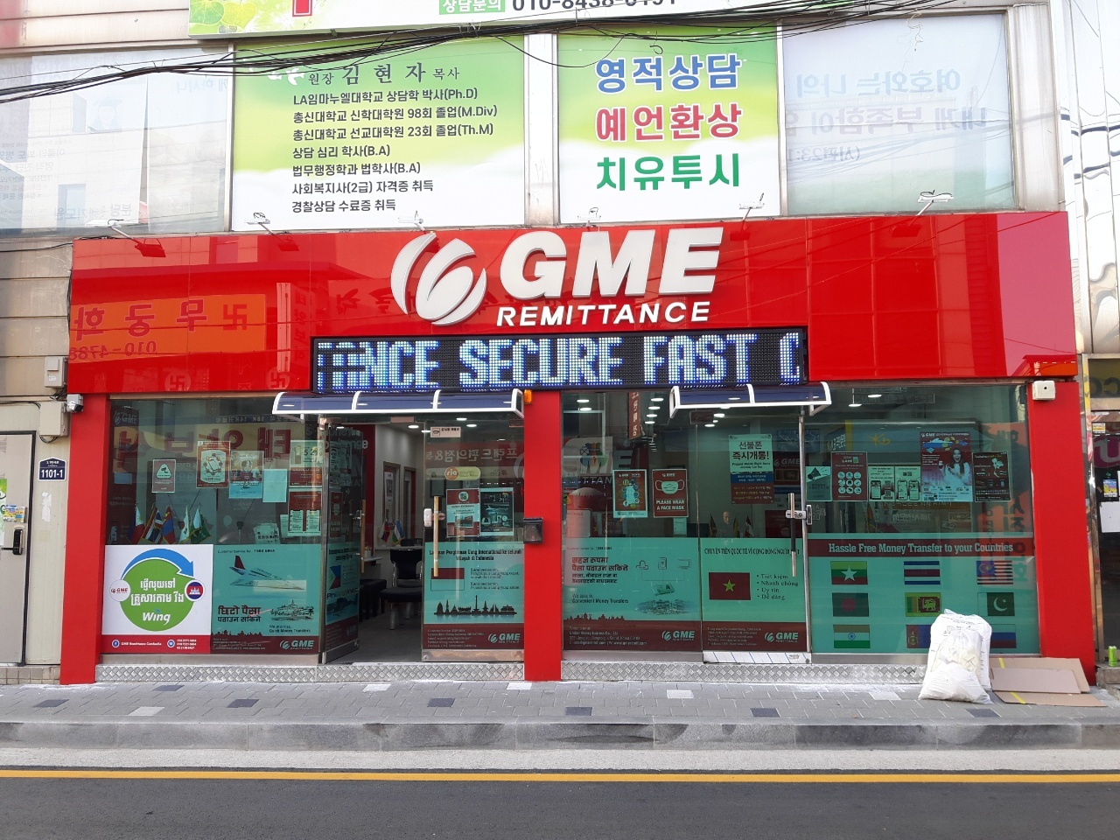
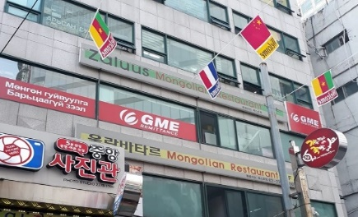
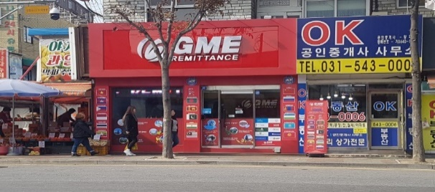
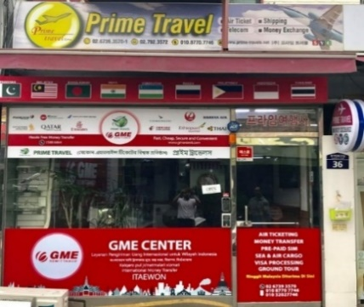
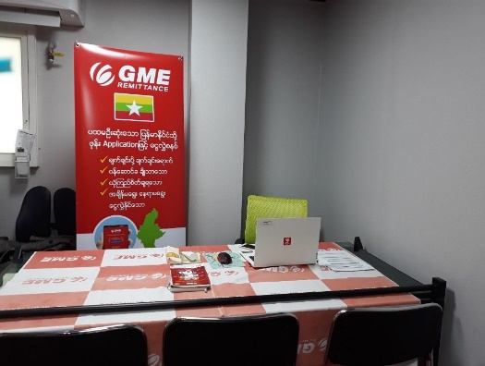
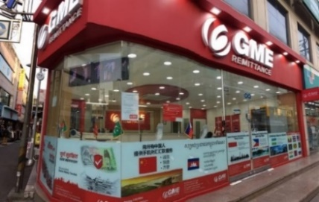
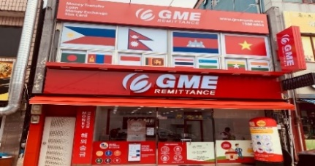
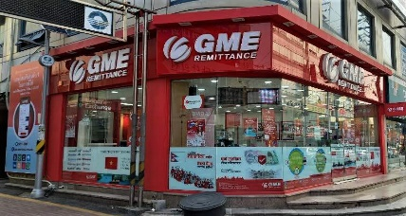
II. e) Strengths
2) Nationwide Branch Network
DDM
Hyehwa
Ansan
Suwon
DDM CIS
Mongol town
Hwaseong
Songu-ri
Itaewon
Bupyeong
Gwangju
Gimhae

Slide 10
IV. a) GME’s Money Transfer Growth
1) Business Result

Slide 11
IV. b) GME’s Money Transfer Growth
2) Future Plan
Aiming at USD 4 Bil (2024)
Remittance market size : USD 40 Bil
GME target size : USD 4 Bil (10%)

Slide 12
V. Toss & GME’s Cooperation
GME will use the Single QR Payment API provided by Toss to provide QR Payment service targeting 2 Mil Foreigners staying in Korea
GME has QR partner in countries such as Nepal, Mongolia, GME can provide the capability for overseas QR payment to Toss

Slide 13
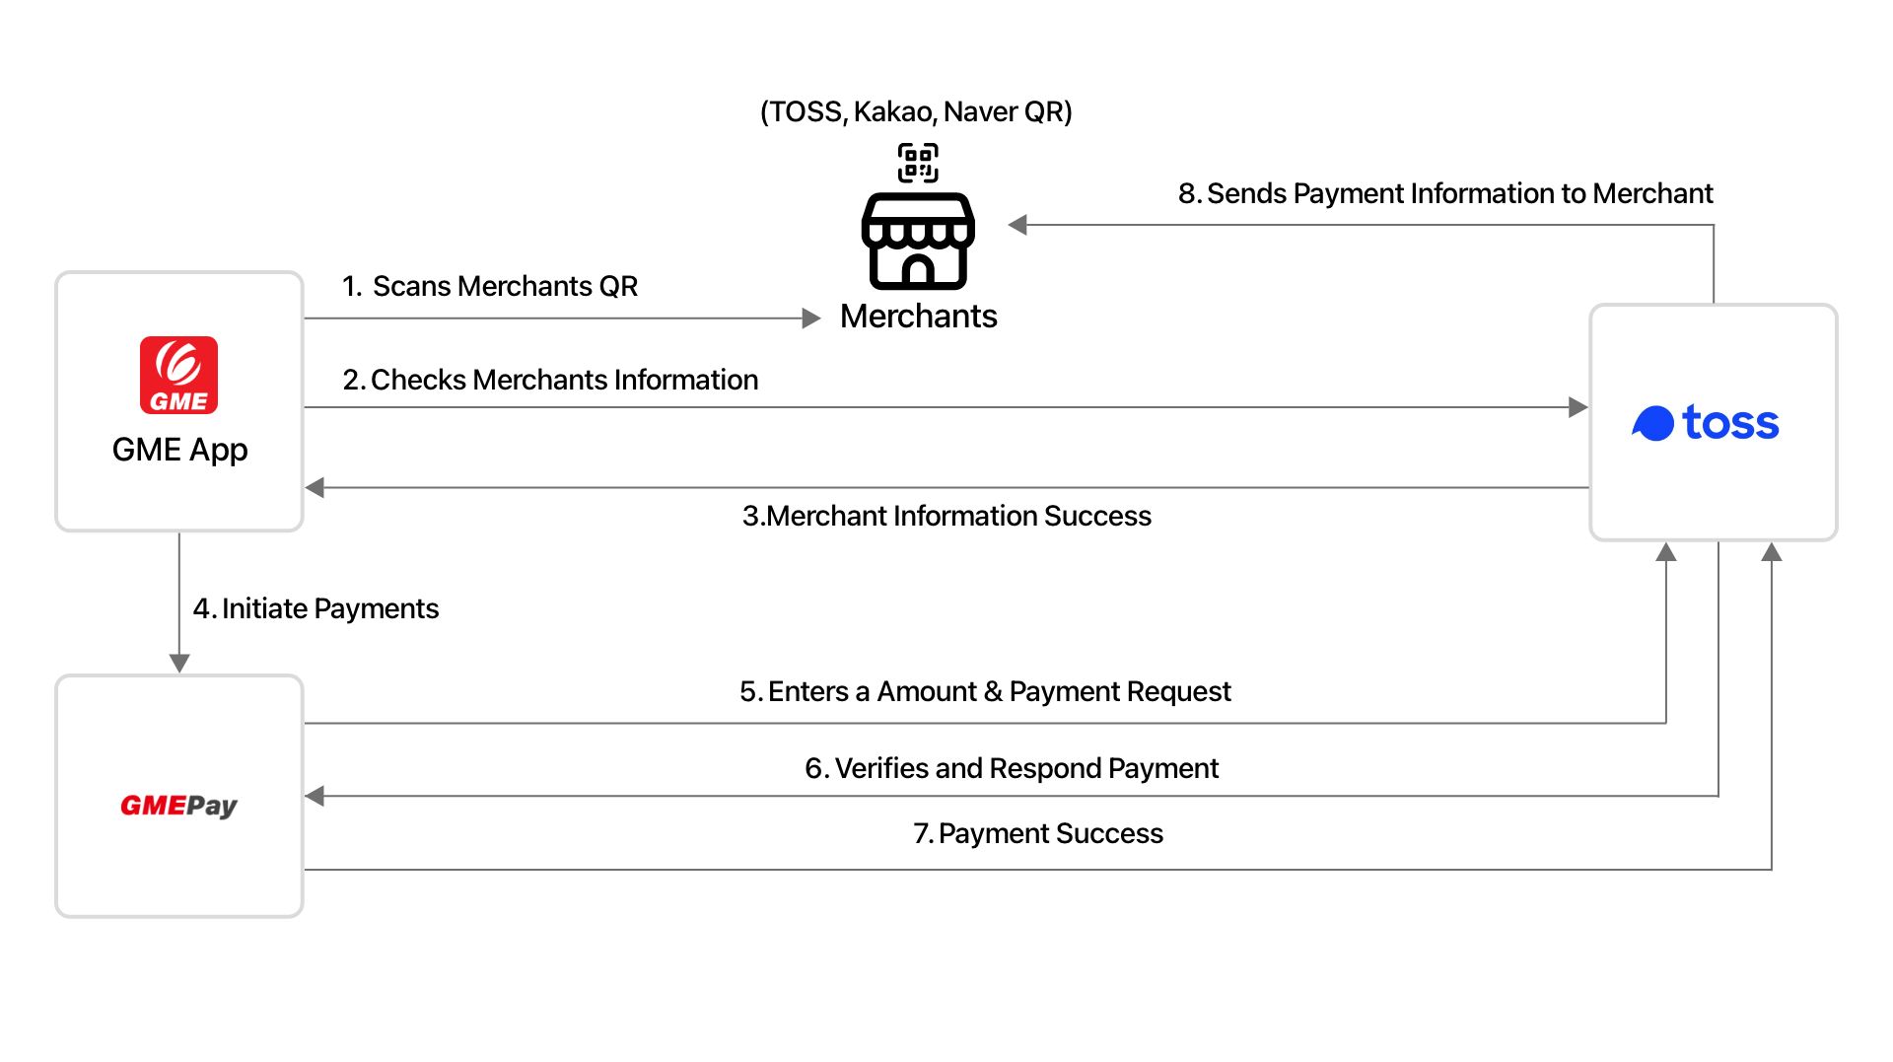
V. Toss & GME’s Cooperation

